Slide 1
ACROPOLIS INSTITUTE Of TECHNOLOGY & RESEARCH
Design & Development of an Event Management System for Educational Institution
Submitted to-
Prof. Praveen Bhanodia
Submitted by-
Aakash Malviya
Darshan Mahajan
Hemant Vinchur
Jayesh Soni
Md. Abuzar Ansari

Slide 2
INDEX
Abstract
Introduction
Survey of Existing System
Objective
Requirement Analysis
Solution Proposed
Diagrams
Implementation
Outcome discussion
Conclusion
Limitation

Slide 3
ABSTRACT
Event management is the website of project management to the creation and development of large scale events such as conferences, seminars, workshops and concerts.
Different teams are needed to hire to manage an event. By EMS it will become very easy to handle all matters of attendee management as well as event marketing.

Slide 4
INTRODUCTION
Event management system (EMS) is a website. It will support online registration and feedback evaluation for event training programs such as games, seminars, and workshops. Development of event management system will be an attempt to address the problems of managing registration forms, feedback forms and evaluating feedback.

Slide 5
SURVEY OF EXISTING SYSTEM
 | Name | Disadvantage
1 | Solution Dots System | Not specific to any institution
2 | Exware Solutions | Long process for registration
3 | Cvent | Difficult for uneducate people

Slide 6
OBJECTIVE
Registering student participants
Collecting feedback from students
Generating feedback reports

Slide 7
REQUIREMENT ANALYSIS
Software Requirements:
Windows 7, Windows 10
MySQL Server 5.5
NetBeans 8.2 or Eclipse
Apache Tomcat Server
Technology used - Front end and Back end:
Java
HTML
MySQL

Slide 8
SOLUTION PROPOSED
We proposed a solution for getting the one and all information about an event by just one visit. It reduces the paper work like entry pass system . The students can register on our website to get the information about event. The student and faculties can create account themselves in “Create an account” block after that they can login and get the detailed information about the events.

Slide 9
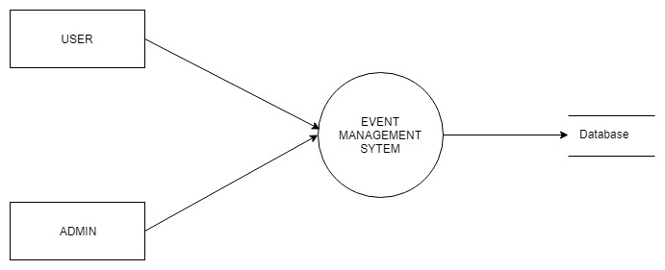
DIAGRAMS DFD 0

Slide 10
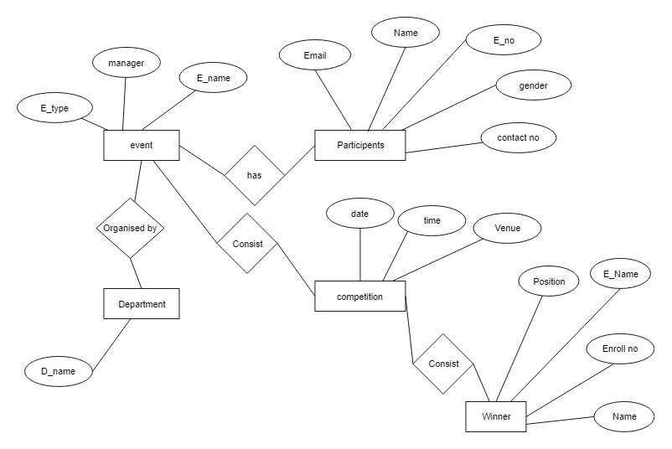
ER DIAGRAM

Slide 11
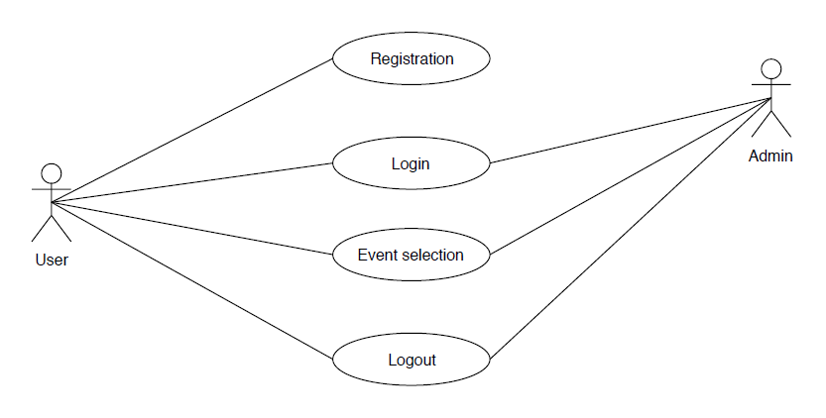
USE CASE

Slide 12
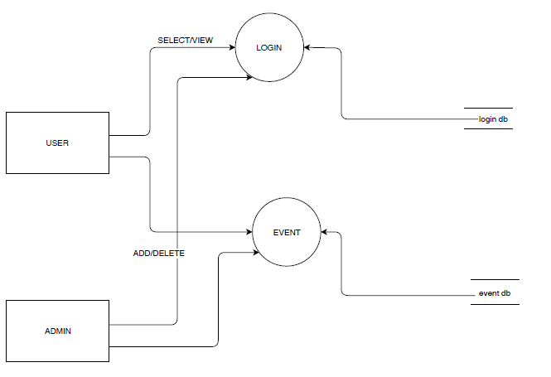
DFD 1

Slide 13
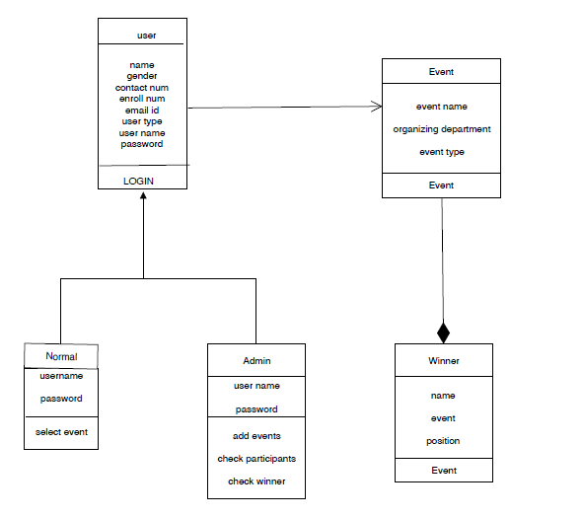
CLASS DIAGRAM

Slide 14
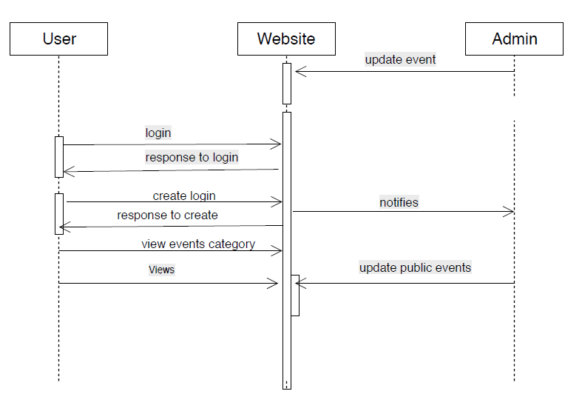
SEQUENCE DIAGRAM

Slide 15
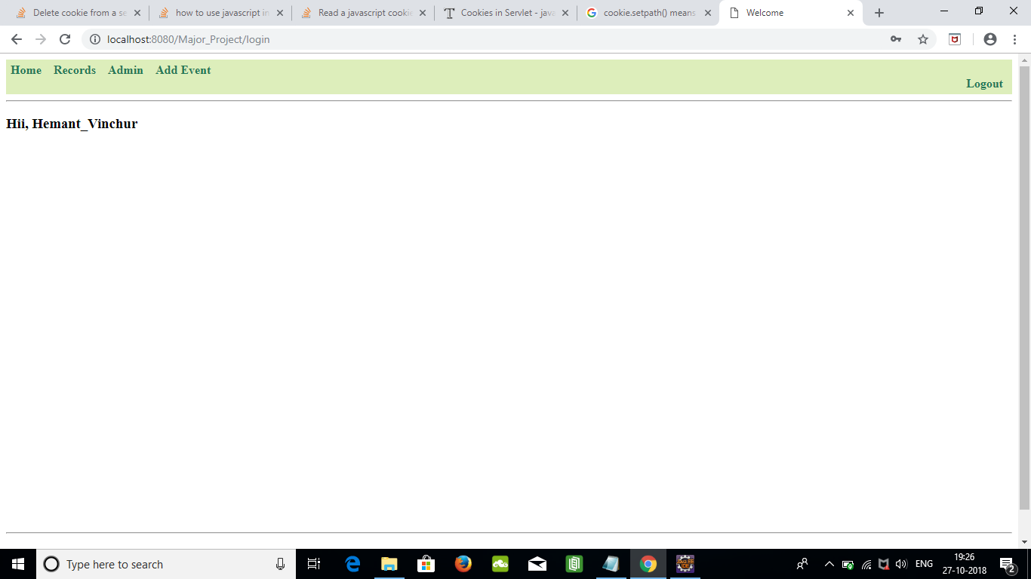
IMPLEMENTATION

Slide 16
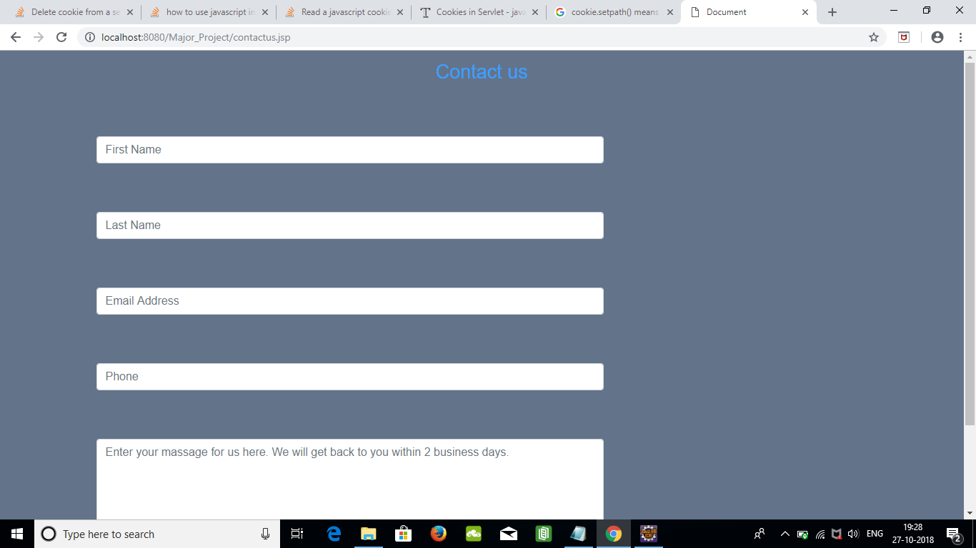
Contact to us

Slide 17
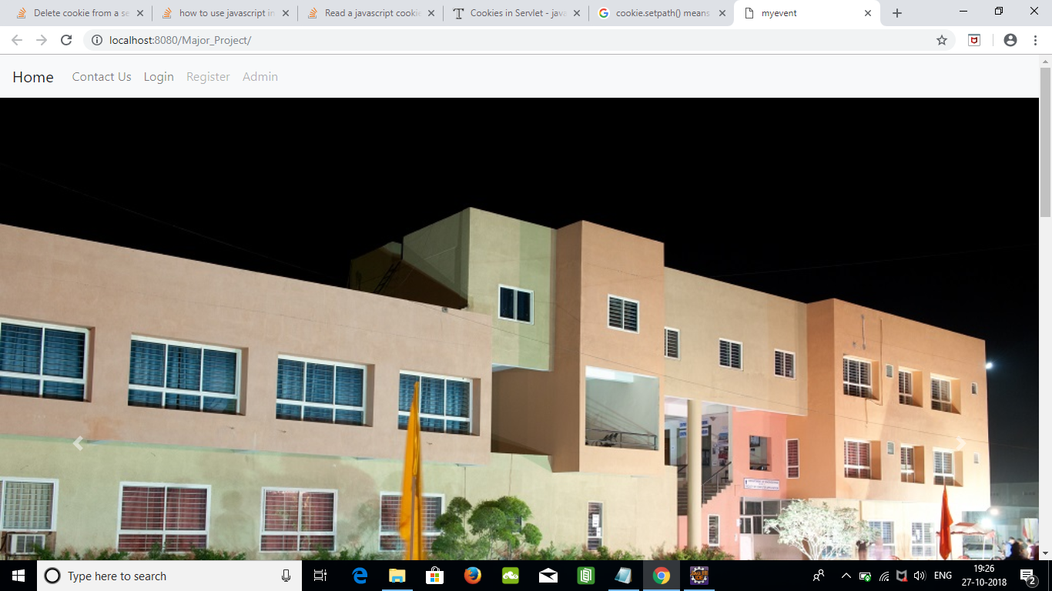
Index of website

Slide 18
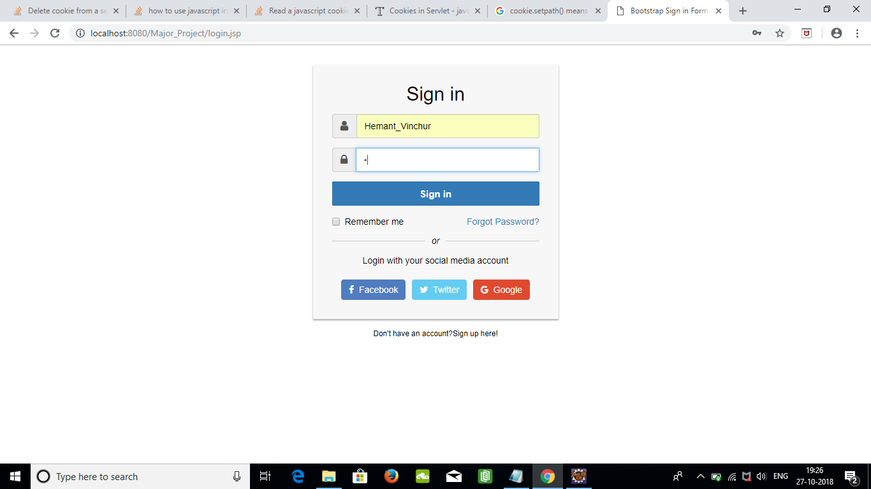
Login page

Slide 19
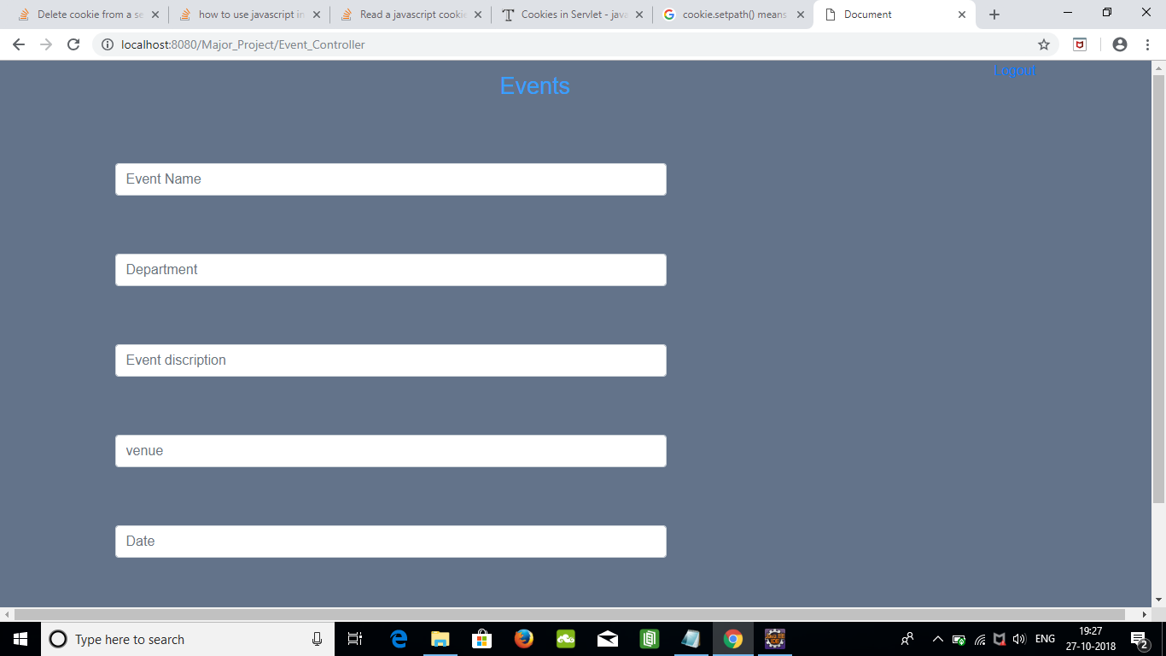
New record

Slide 20
THE OUTCOMES DISCUSSION
The scope of the project is that it is developed for a particular institution only like Acropolis Institute of Technology and Research. It only gives the information about the workshops , event held in different departments . Our website can not give the information about events which are on going in the city.

Slide 21
LIMITATIONS
It will not give the event information of other institutions.
We are not providing the android application yet.

Slide 22
CONCLUSION
Event Management System will be a website developed in Java programming language. It facilitates online registration and feedback evaluation for different kinds of events such as games, workshops, and seminars. Our main objective is to control or manage the activities and duties to be preformed by various event conductors.

Slide 23
Thank You..!

